Slide 1
*Background
the company needs to understand which aircraft models present the lowest risk in terms of safety, reliability, and overall performance. By examining data from the aviation sector, such as accident rates, aircraft maintenance records, and safety trends, your company can make informed decisions about which aircraft models to invest in. The ultimate goal is to ensure the company's new aviation division starts with the safest and most reliable aircraft fleet, minimizing risk while maximizing operational efficiency.

Slide 2
* Problem Statement
Your company is expanding in to new industries to diversify its portfolio. Specifically, they are interested in purchasing and operating airplanes for commercial and private enterprises, but do not know anything about the potential risks of aircraft. You are charged with determining which aircraft are the lowest risk for the company to start this new business endeavor. You must then translate your findings into actionable insights that the head of the new aviation division can use to help decide which aircraft to purchase

Slide 3
* Goals
My Client:
a company expanding into the aviation industry, is seeking to diversify its portfolio by purchasing and operating aircraft for both commercial and private enterprises.
The Goal:
The goal is to assess various aircraft in terms of risk factors such as safety, maintenance, operational efficiency, and accident history. In order to purchase the Aircraft with the lowest risk.
There are variables that i believe can impact these.
. 1. Make
2. Model
3. weather condition
4. Engine type
5. Injury severity
Lets look at each one of them so as to come up with
recommendations.

Slide 4
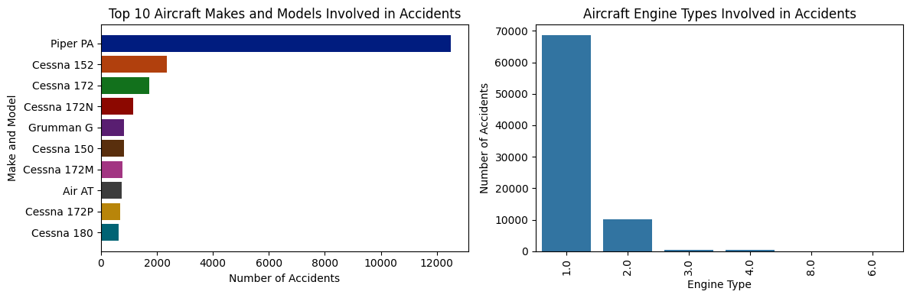
* Top 10 Aircraft make and models involved in accident.

Slide 5
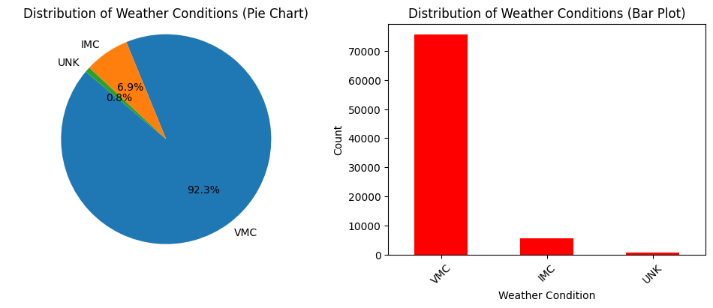
* Distribution Of Weather Conditions

Slide 6
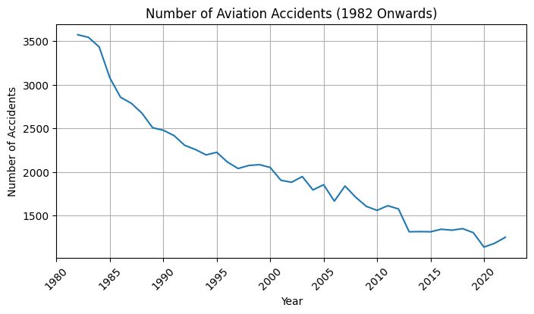
* Number Of aviation acidents

Slide 7
* Conclusion
> The bottom line for the "success" of a the company purchasing Aircrafts with the lowest risk is going with the aircraft involved with the least accidents
> Variables that may influence the "success" of a Safe Aircraft:
1. Make
2. Model
3. weather condition
4. Engine type
5. Injury severity

Slide 8
* Reccomendations
The decrease in aviation accidents since 1982 is encouraging, but it's clear that certain states, such as California, Texas, and Florida, still experience significantly higher accident rates. To address this issue, it is imperative to continually enhance safety protocols, regulations, and procedures. Regular reviews and updates of these measures are essential to stay ahead of emerging risks. In high-accident states, there should be a concerted effort to increase surveillance and regulatory enforcement activities to mitigate the risks associated with aviation accidents.
Most accidents happen in good weather conditions. In good weather conditions, pilots may become complacent, assuming there are fewer risks compared to poor weather conditions. This can lead to a lax attitude toward safety protocols and potentially risky behaviors, such as low-level flying, excessive speed, or aerobatics, which increase the likelihood of accidents. To address this issue, it is recommended to promote responsible flying and discourage risky behaviors through training and awareness campaigns. Reinforcing the importance of flying within established safety parameters is crucial to preventing accidents.
. Personal flights are responsible for big portion of aviation accidents. For personal flights, comprehensive education and training programs should be promoted for pilots. Encouraging a safety-first culture within the personal aviation community is essential. Making safety a top priority in all personal flight activities is crucial to reducing accidents. Pilots must be well-prepared and aware of the potential risks associated with personal aviation, regardless of the weather conditions
To further enhance aviation safety, rigorous maintenance and inspection programs should be implemented for specific makes and models that have shown a higher accident rate. Collaboration with aircraft manufacturers is vital to identify any design or manufacturing issues that may contribute to accidents. This proactive approach to maintenance and collaboration can help identify and rectify potential safety hazards before they lead to accidents, thus improving overall aviation safety

Slide 9
Thank You. God Bless You

